Slide 1
Lecture 8
NumPy

Slide 2
Learning Objectives Today
Computation on Arrays: Broadcasting
Comparisons, Masks, and Boolean Logic
Fancy Indexing
Sorting Arrays
Structured Data: NumPy’s Structured Arrays

Slide 3
Python Array vs NumPy
Python's built-in array module and NumPy arrays are both used for storing collections of elements, but they differ in their purpose and capabilities.
The array module is suitable for storing arrays of basic values like characters, integers, and floating-point numbers. It provides a more memory-efficient alternative to lists when you need to store a large number of homogeneous data types. However, the array module lacks advanced mathematical functions and is not optimized for numerical computations.
On the other hand, NumPy arrays are designed for efficient numerical operations and scientific computing. They offer a wide range of functions and methods for performing mathematical operations on arrays, such as element-wise operations, linear algebra, and Fourier transforms. NumPy arrays are more memory-efficient than lists and can handle multi-dimensional arrays with ease.

Slide 4
Python Array
import array as arr
a = arr.array('i', [1, 2, 3]) # array of integers
b = arr.array('d', [2.5, 3.2, 3.3]) # array of floats
print(a)
print(b)
print(a[0])

Slide 5
Python Array Functions
append(x): Adds an element at the end of the array
insert(i, x): Inserts an element at the specified position
remove(x): Removes the first occurrence of the specified element
pop(i): Removes and returns the element at the specified position
index(x): Returns the index of the first occurrence of the specified element
reverse(): Reverses the order of the elements in the array
import array as art
n = art.array('i', [11, 6, 33, 55, 23, 99, 65])
n.reverse()
print(n)

Slide 6
NumPy
import numpy as np
myArr = np.array([2, 4, 6, 3, 55, 23, 33])
print(myArr)
TwoDArr = np.array([range(i, i + 3) for i in [2, 4, 6]])
print(TwoDArr)

Slide 7
How about empty array?
arr = np.zeros(10, dtype=int)
print(arr)
arr = np.ones((5,3), dtype='float32')
print(arr)
Try IT

Slide 8
Some More?
arr = np.arange(0, 20, 2)
print(arr)
arr = np.linspace(0, 1, 5)
print(arr)
arr = np.random.random((3,3))
print(arr)

Slide 9
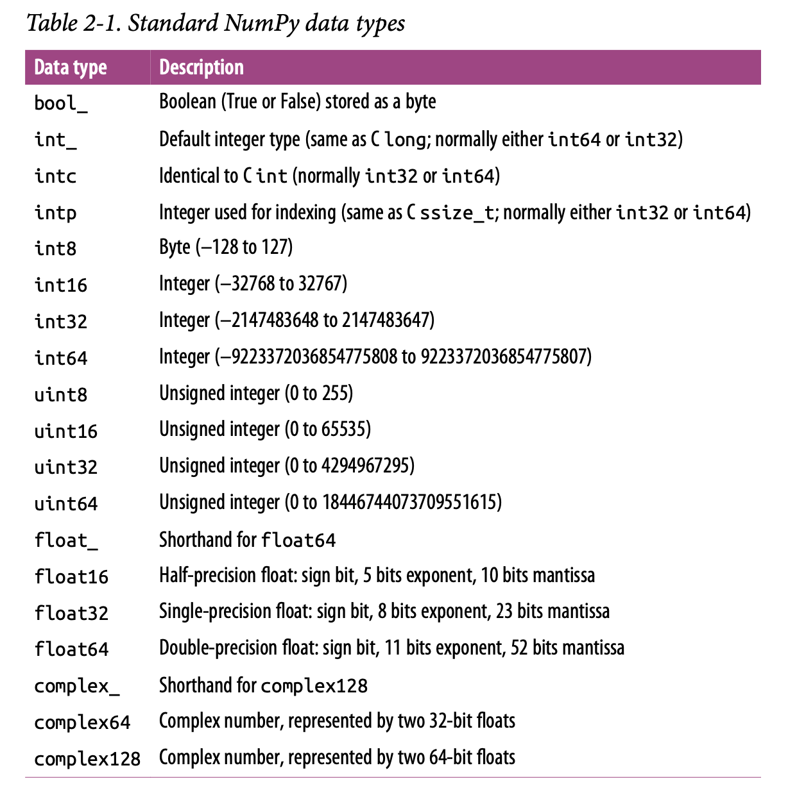
Data Types

Slide 10
Vectorized Operations
arr1 = np.random.randint(1,10, size=10)
print(arr1)
arr2 = np.random.randint(1,10, size=10)
print(arr2)
arr1 = arr1 - arr2
print(arr1)

Slide 11
Array Broadcasting
Import pandas as pd
data = pd.read_csv("SampleData.csv")
#print(data)
units = np.array(data['Units'])
unit_cost = np.array(data['Unit Cost'])
total = units * unit_cost #Broadcasting
print(total)

Slide 12
Broadcasting
print(units)
temp = units + 5
print(temp)

Slide 13
Broadcasting Rules
Rule 1: If the two arrays differ in their number of dimensions, the shape of the one with fewer dimensions is padded with ones on its leading (left) side.
Rule 2: If the shape of the two arrays does not match in any dimension, the array with shape equal to 1 in that dimension is stretched to match the other shape.
Rule 3: If in any dimension the sizes disagree and neither is equal to 1, an error is raised.

Slide 14
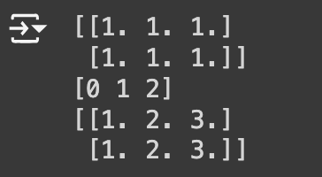
Broadcasting Rules
M = np.ones((2, 3))
a = np.arange(3)
print(M)
print(a)
temp = M+a
print(temp)
Rule 1: Add 1 to left
(2,3)
(1, 3)
Rule 2: Stretch dimension
(2,3)
(2,3)
Rule 3: Match and perform

Slide 15
Broadcasting
Rule 1: Add 1 to left
(3,2)
(1, 3)
Rule 2: Stretch dimension
(3,2)
(3,3)
Rule 3: Didn’t Match
M = np.ones((3, 2))
a = np.arange(3)
print(M+a)
ERROR

Slide 16
Try Out
Problem: You have two NumPy arrays, one representing the temperature in Celsius and another representing the temperature in Fahrenheit. You want to convert the Celsius temperatures to Fahrenheit using element-wise operations and broadcasting.
Given:
celsius_temps array: ``
fahrenheit_temps array: ``
Write a NumPy code snippet to convert the Celsius temperatures to Fahrenheit using broadcasting.
After, conversion check if converted array is equal to fahrenheit_temps or not.

Slide 17
Try Out Solution
import numpy as np
# Given arrays
celsius_temps = np.array([20, 25, 30, 35])
fahrenheit_temps = np.array([68, 77, 86, 95])
# Convert Celsius to Fahrenheit using broadcasting
fahrenheit_temps_converted = (celsius_temps * 9/5) + 32
# Print the results
print("Celsius Temperatures:", celsius_temps)
print("Fahrenheit Temperatures (original):", fahrenheit_temps)
print("Fahrenheit Temperatures (converted):", fahrenheit_temps_converted)
print(np.array_equal(fahrenheit_temps,fahrenheit_temps_converted))

Slide 18
Try Out
You have a NumPy array representing student scores on three exams, and you want to calculate the average score for each student. However, one student has a bonus score added to their exam scores. Use NumPy's broadcasting to calculate the average scores for all students.
Given:
Exam scores array for each student: exam_scores = np.array([, , ])
Bonus score for one student: bonus_score = 5
Write a NumPy code snippet to calculate the average scores for all students, considering the bonus score for one student using broadcasting.

Slide 19
Comparisons, Masking, Boolean Logic
x = np.array([1, 2, 3, 4, 5])
print(x>=3)
print(x!=3)
[False False True True True]
[ True True False True True]

Slide 20
Comparisons, Masking, Boolean Logic
x = np.array([34, 22, 13, 45, 51, 33, 11])
temp = np.where(x<=25)
print(temp)
temp = np.sum(x<=25)
print(temp)
(array([1, 2, 6]),) #Index numbers
3

Slide 21
Comparisons, Masking, Boolean Logic
x = np.array([1, 2, 3, 4, 5])
y = np.array([1, 2, 3, 4, 5])
z = np.array([6, 7, 8, 9, 10])
temp = np.any(x==z)
print(temp)
temp = np.all(x==y)
print(temp)

Slide 22
Comparisons, Masking, Boolean Logic
print(units)
temp = (units>20)
print(temp)
temp = ((units>20) & (units<80))
print(temp)

Slide 23
Iterate NumPy Array
arr1d = np.array([5, 10, 15, 20, 25, 30])
for element in arr1d:
print(element)
arr2d = np.array([[5, 10], [15, 20], [25, 30]])
for row in arr2d:
print(row)

Slide 24
Iterate NumPy Array
arr2d = np.array([[5, 10], [15, 20], [25, 30]])
for col in range(arr2d.shape[1]):
print(arr2d[:, col])
arr = np.array([[1, 2, 3], [4, 5, 6], [7, 8, 9]])
for row in arr:
for elem in row:
print(elem)

Slide 25
Fancy Indexing
x = np.random.randint(100, size=10)
print(x)
print(x[[0,2,4]])
ind = [0,2,4]
print(x[ind])

Slide 26
Fancy Indexing
X = np.arange(12).reshape((3, 4))
print(X)
row = np.array([0, 1, 2])
col = np.array([2, 1, 3])
print(X[row, col])

Slide 27
Sorting NumPy Array
x = np.array([2, 1, 4, 3, 5])
temp = np.sort(x)
print(temp)
print(x)
x.sort()
print(x)

Slide 28
Sorting
# Sorted Indices
x = np.array([2, 1, 4, 3, 5])
i = np.argsort(x)
print(i)

Slide 29
Row / Column wise 2D array sort
# Row and Column wise sort
rand = np.random.RandomState(42)
X = rand.randint(0, 10, (4, 6))
print(X)
# sort each column of X
temp = np.sort(X, axis=0)
print(temp)
# sort each row of X
temp = np.sort(X, axis=1)
print(temp)

Slide 30
Structured Data / NumPy Structured Array
name = ['Alice', 'Bob', 'Cathy', 'Doug']
age = [25, 45, 37, 19]
weight = [55.0, 85.5, 68.0, 61.5]
data = np.dtype({'names':('name', 'age', 'weight'),
'formats':('U10', 'i4', 'f8')})
data = np.zeros(4, dtype=data)
data['name'] = name
data['age'] = age
data['weight'] = weight
print(data)
for ele in data:
print(ele)
print(ele['name'],ele['age'],ele['weight'])

Slide 31
Structured Data
coord_dtype = np.dtype([('latitude', np.float64), ('longitude', np.float64)])
coords = np.array([(37.7749, -122.4194), (40.7128, -74.0060), (51.5074, -0.1278)], dtype=coord_dtype)
print(coords)

